Slide 1


Genetic Algorithm using C++

Slide 2
Problem Statement
Determine the optimal order to visit the malls for shopping to maximize the discount with minimum given time limit.
Point to considerate before proceeding, Optimizing the given problem using genetic algorithm, considering time limit as fitness value and corresponding discount will be the convergence condition.
If we are visiting any mall it will be represented by 1 otherwise 0.collection of 1 and 0 will form genome/chromosome.

Slide 3
Genetic Algorithm Phases
Initialization
Initialize random population
Find corresponding fitness value
Selection
Pick fittest 2 genome
Crossover
Single point crossover
Break in half
merge

Slide 4
Genetic Algorithm Phases
Mutation
Find random index in range
Find random probability (0-1)
Change the value 0->1 or 1->0
Check if converge
Discount <prev discount
Terminate
If Converge,
Optimal solution found
terminate

Slide 5
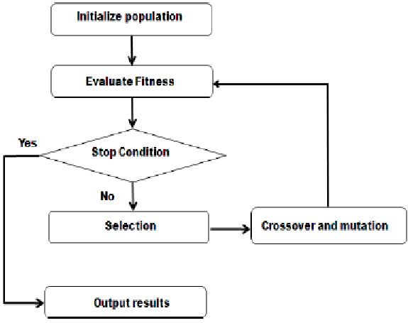

Slide 6
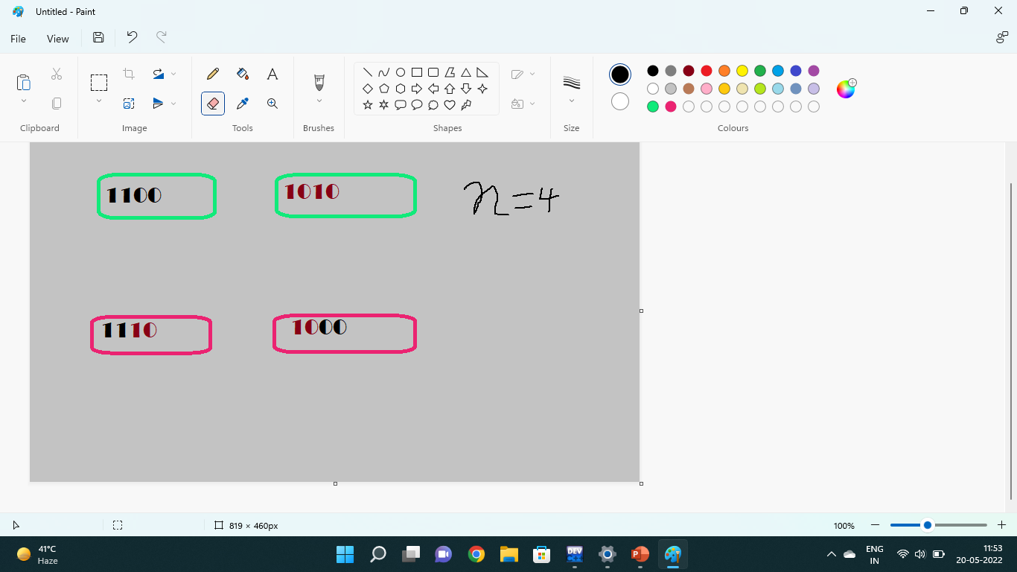
Crossover

Slide 7
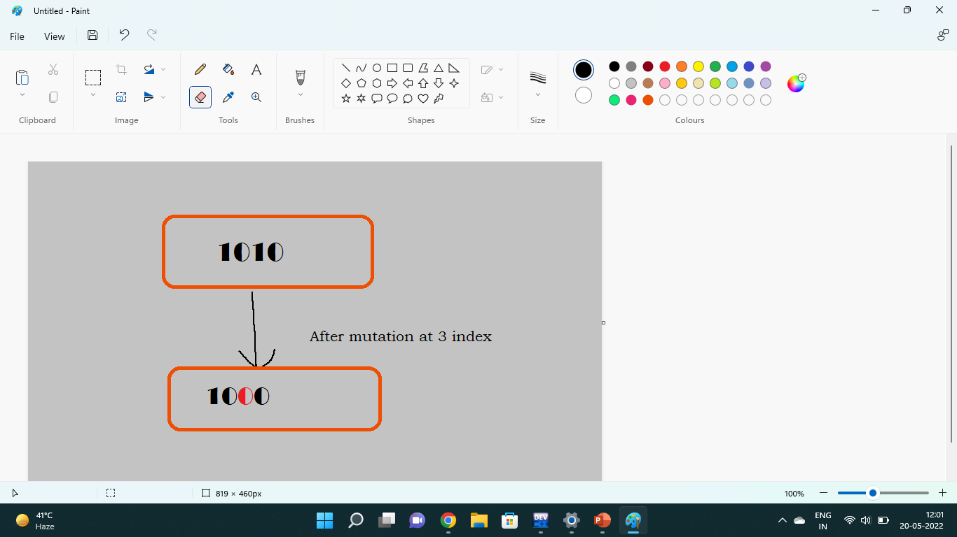
Mutation

Slide 8


